Slide 1
The REAL Moneyball
Machine Learning and Predictive Analytics
University of Chicago
December 11, 2020

Slide 2
Agenda
Background/Problem Statement
Data source
Assumptions/Hypotheses/Limitations
Benchmarking
Data Properties & Transformations
ML models
DL models
Best model results
Future Work

Slide 3
Background/Problem Statement
McKinsey issued a report on daily fantasy sports in 2015:
Total entry fees exceeded $1B (all sports)
The top 1.3% of players account for 91% of profits for MLB daily fantasy sports
In the first half of the 2015 season, the top 11 MLB players had made $135K each, with the top player making $400k.
These figures are likely significantly larger now
Goal: a ML model to predict individual MLB player performance per game based on FanDuel’s scoring system
Notes:
https://arxiv.org/abs/1604.01455

Slide 4

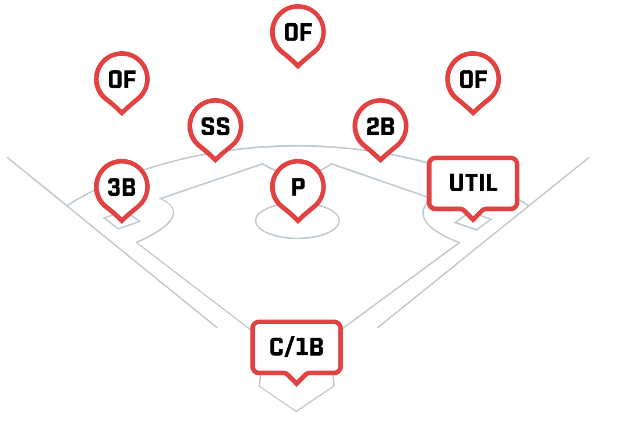
Data
Data from 2006 to 2019 was downloaded from Retrosheet.org
Play-by-play file with result of every single at-bat
2.7M records
Box Scores with high-level summary of every game
Compared annual totals to Baseball Reference.com to check data processed correctly
Predict points for every starting player on a game-by-game basis
500K records

Slide 5
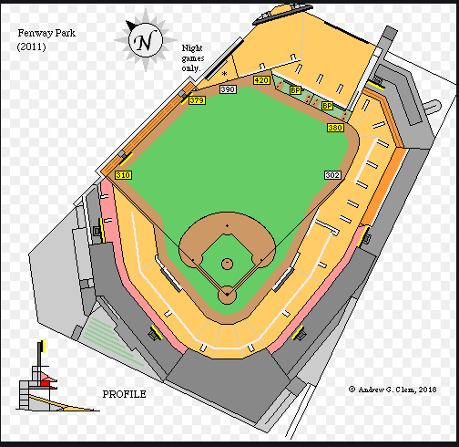
Assumptions/Hypotheses/Limitations
1.) Individual Player Skill
Average of X games
2.) Opposing Pitcher Skill
3.) Game Location
Home vs Away
Park Dimensions
4.) Opposing Team Bullpen
5.) Opposing Team Defense
6.) Team Offense
Especially players within 2 lineup positions
7.) Weather Forecast
Outdoor stadiums only
8.) Lineup position
Especially if it changes
9.) Assumptions for rookies (limited data available)
10.) Opposing Pitcher Style vs. Batter Strengths
E.g. curveball pitcher vs fastball hitter
11.) BoxCox transformation on points
rank | park | park_factor_SLG
1 | COL | 113.1%
2 | BAL | 108.6%
3 | TEX | 106.5%
4 | CIN | 105.8%
5 | ARI | 105.3%
6 | KCA | 104.3%
7 | MIN | 104.2%
8 | PHI | 103.9%
9 | DET | 103.4%
10 | TOR | 103.2%
11 | CHA | 102.7%
12 | BOS | 101.7%
13 | MIL | 101.6%
14 | HOU | 101.0%
15 | NYA | 100.0%
16 | CLE | 99.9%
17 | PIT | 98.5%
18 | WAS | 98.4%
19 | ANA | 97.5%
20 | SEA | 97.5%
21 | CHN | 97.3%
22 | ATL | 95.8%
23 | NYN | 94.8%
24 | MIA | 94.5%
25 | TBA | 94.3%
26 | SLN | 93.6%
27 | SFN | 93.1%
28 | SDN | 92.9%
29 | OAK | 92.9%
30 | LAN | 90.0%
Notes:
https://arxiv.org/abs/1604.01455

Slide 6
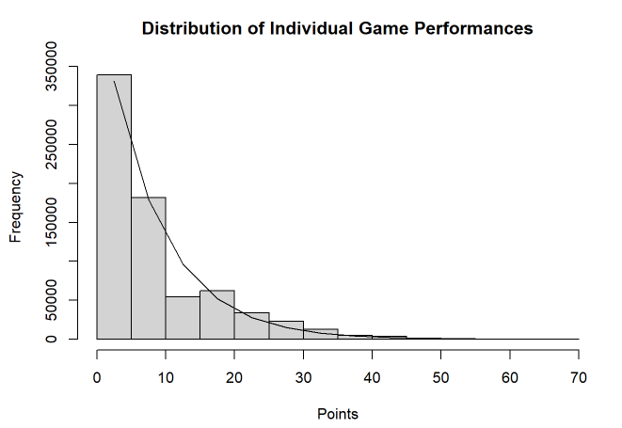
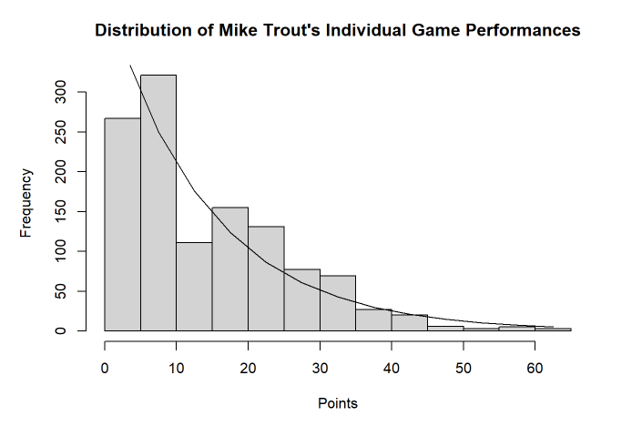
Benchmark
Results are approximately exponentially distributed
0 points is the most frequent result
29% of all records, 11% of games for Mike Trout
What is a good result for such inherently random data?
Fit: Exponential with mean = 8.1
Fit: Exponential with mean = 14.2

Slide 7

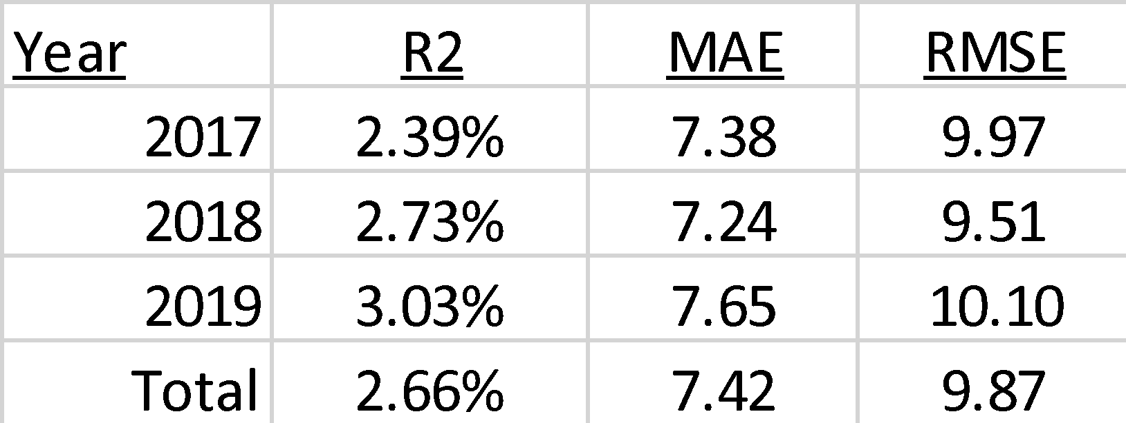
Benchmark (cont.)
Professors at MIT made $15,000 on Daily Fantasy NHL over an 11-week period using a combination of RotoGrinders and Daily Fantasy Nerd predictions (63% and 28%, respectively) and constructing lineups using linear programming.
They mention they performed a similar (but only hypothetical) study on baseball that also proved successful
Therefore, we have used predictions from the website RotoGrinders as the benchmark to evaluate our predictions
https://mitsloan.mit.edu/shared/ods/documents/?DocumentID=2858

Slide 8
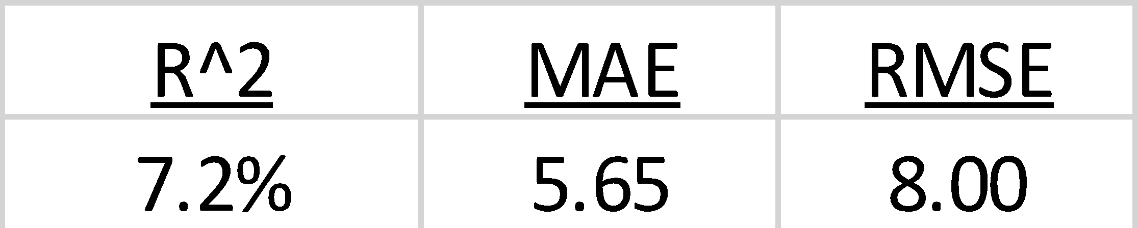
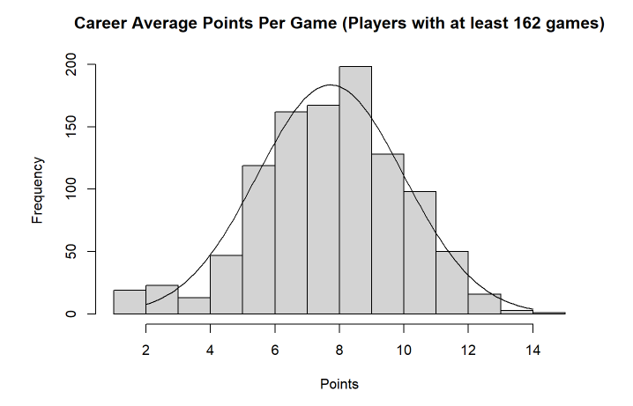
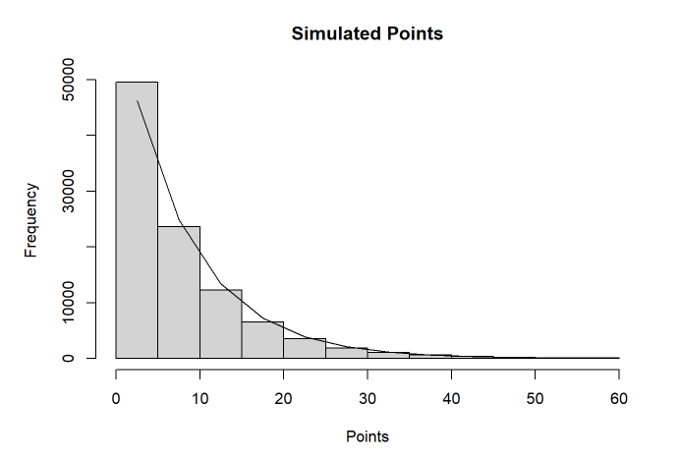
Benchmark (cont.)
Hypothetical best possible model
Assume points are exponentially distributed with means that are N(7.7, 2.3²), limited to the interval [2,14]
Prediction is mean of exponential variable
Result is simulated exponential random variable with mean = prediction
Fit: Normal ~ (7.7, 2.3²)
Fit: Exponential with mean = 8.1
(mean from actual distribution)

Slide 9
Model EDA with PyCaret
Advantages:
Low code Python library
High level overview of regression models and their results
Ideas for exploration (accuracy vs time)
Disadvantages:
Blackbox solution
Notes:
https://arxiv.org/abs/1604.01455

Slide 10
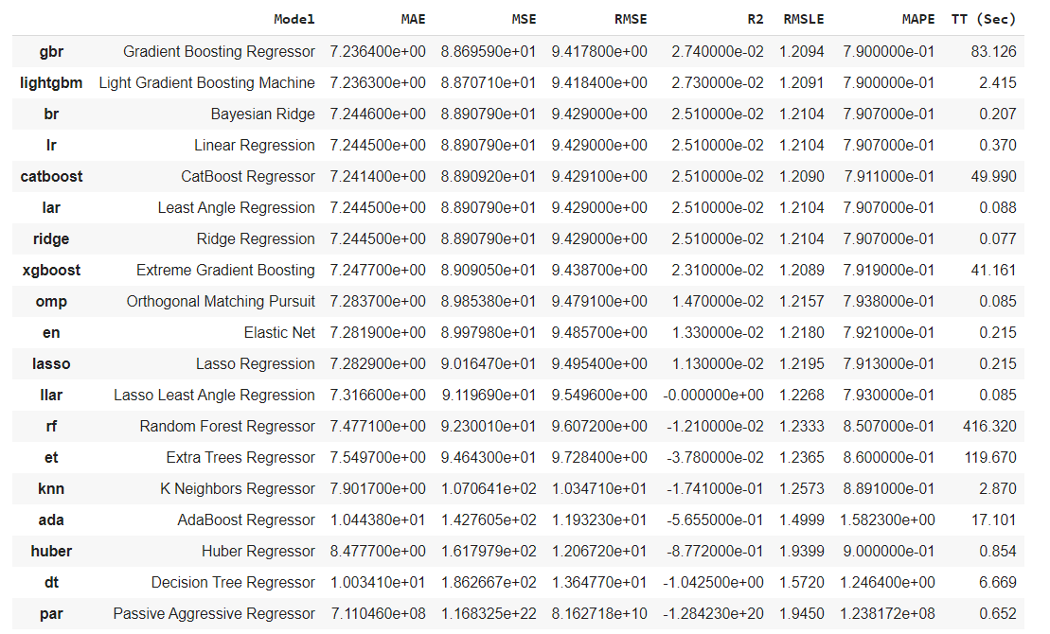
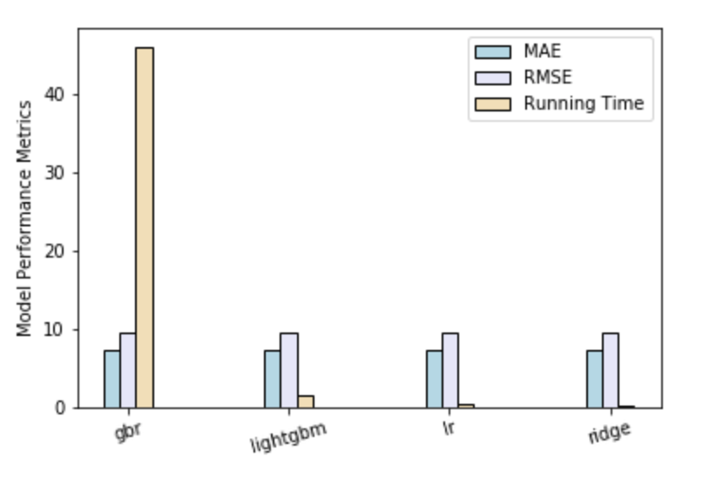
PyCaret overview
Notes:
https://arxiv.org/abs/1604.01455

Slide 11
Feature engineering
Combinations of different features, based on their importance
Gradient Boosting as a baseline
Datasets of different sizes (data between 2007 and 2019)
Baseball and statistics change with time
Grid and Random Search for tuning hyperparameters
No breakthrough; small improvements
Data scaling (StandardScaler)
Different rolling windows of bats (1000, 500, 250, 100)
Notes:
https://arxiv.org/abs/1604.01455

Slide 12
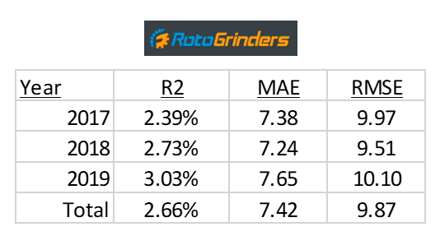
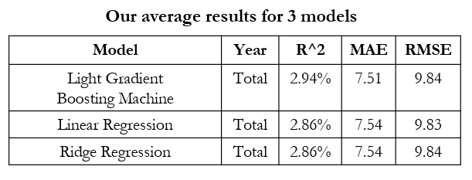
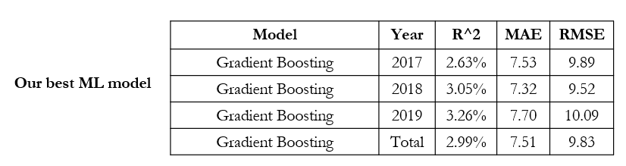
ML performance vs paper baseline
Notes:
https://arxiv.org/abs/1604.01455

Slide 13
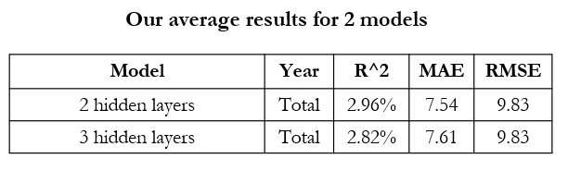
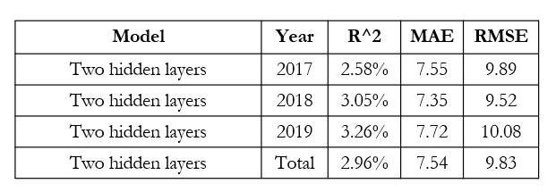
Deep learning vs paper baseline
Our Best DL model
Notes:
https://arxiv.org/abs/1604.01455

Slide 14
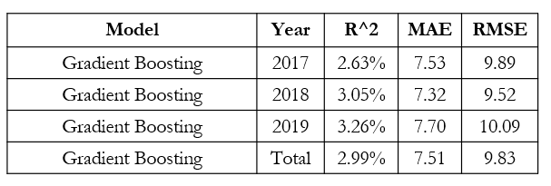
Comparison of best models
Notes:
https://arxiv.org/abs/1604.01455

Slide 15
Future work
Add additional data identified earlier
Park Adjustments split by batter handedness
Neural Net using raw data
Construct 150 lineups per day using linear programming
Maximize expected value
Maximize variance
Minimize correlation between lineups
Compare results to past competition
Simulate P&L
Notes:
https://arxiv.org/abs/1604.01455

Slide 16
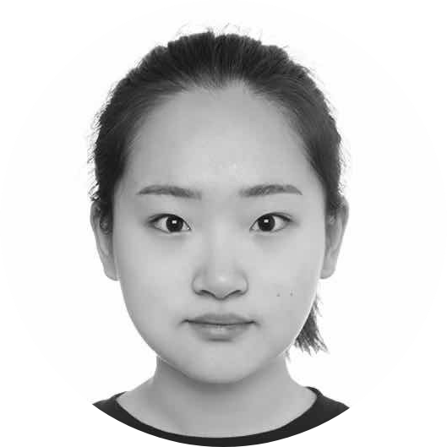


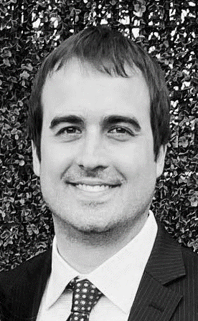

Our team
Serena Hanwen Xu
Adrienne Wang
Oleksiy Anokhin​
Mike Thompson

Slide 17
Q & A

